Slide 1

SMART GROCERY MANAGEMENT SYSTEM CSA0890 K.MUKESH(192211138) M.MOHANA VENKATA MANOJ(192211137) R.MOHAN KRISHNA(192211555)
GUIDED BY:​ ​ DR.R.YUVARANI​

Slide 2
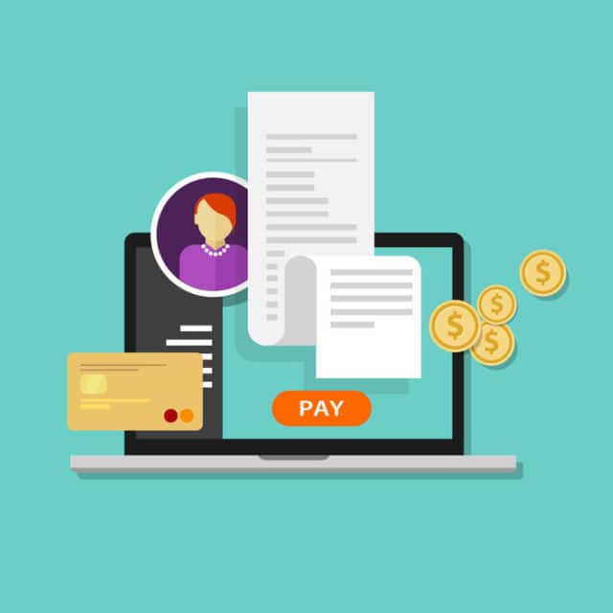
ABSTRACT
This project focuses on the design and implementation of a comprehensive billing software system using the Python programming language. The objective is to create a user-friendly, efficient, and scalable solution that caters to the needs of businesses in managing their billing processes.
This Photo by Unknown author is licensed under CC BY.

Slide 3

INTRODUCTION
Billing software is a specialized application designed to streamline and automate the financial processes associated with invoicing and transactions within a business. Whether you run a small enterprise, a freelancing business, or a larger corporation, effective billing management is crucial for maintaining financial accuracy, efficiency, and customer satisfaction.
Billing software serves as a digital solution to replace manual invoicing and payment tracking systems, offering a range of features to simplify complex financial tasks.
This Photo by Unknown author is licensed under CC BY-SA-NC.

Slide 4
PROCEDURE Efficiently manage and organize a database of products or services offered by the business. Enable functionalities to add new customers, update existing records, and manage customer-specific details. Implement automated calculations for pricing, taxes, and discounts, providing accuracy in billing. Track and record financial transactions associated with each invoice. Design the system with scalability in mind to accommodate the growth of the business.
Product Management
Customer Database
Invoicing
Transaction Tracking
Reporting
User Interface
Scalability and Extensibility

Slide 5
MODULES:
Invoice Generation Module
Customer Management Module
Product/Service Database Module
Payment Processing Module
Tax Calculation Module
Reporting and Analytics Module
Integration Module
Security Module

Slide 6
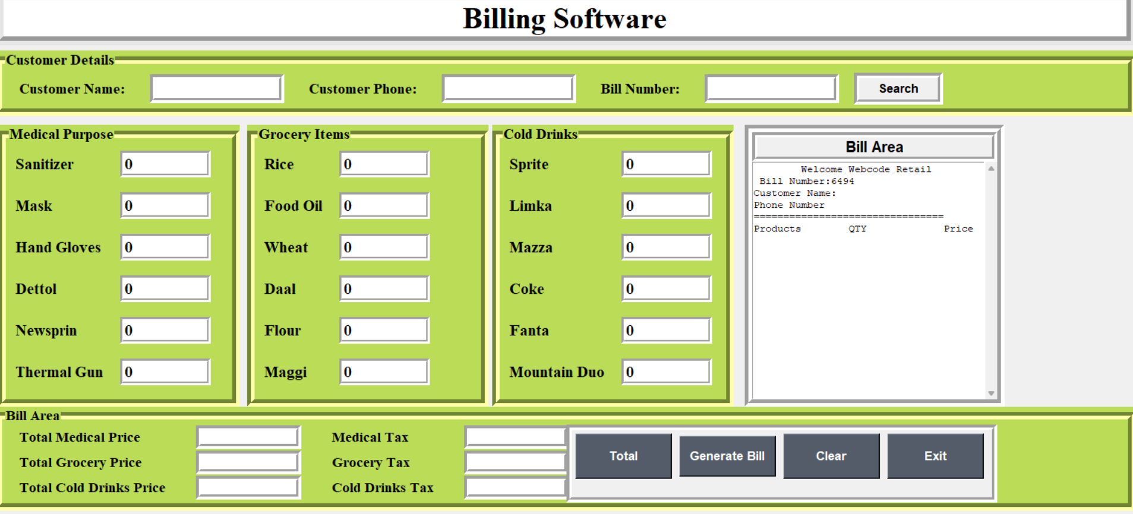

Slide 7
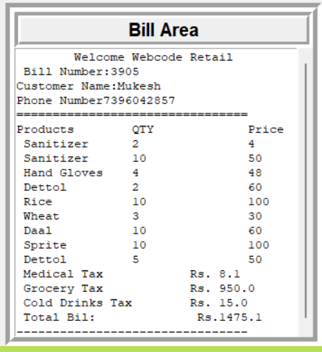
OUTPUT :
Bill area dashboard consisting of various segments such as products , quantity , including with price and taxes. It provides more information about the calculation of customer products effortlessly . It consists of bill numbers and customer name with their mobile number to contact and takes the feedback from the customer. The bill that generates in digital format via paper the can easily to understand the expenditure of customer products.

Slide 8
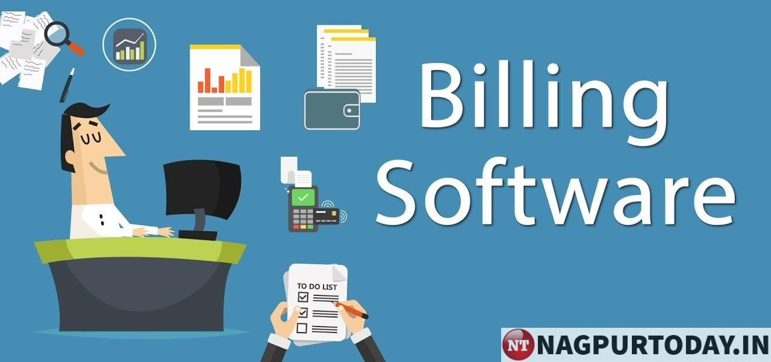
RESULTS: We'll create a class named ' Billing System ' with various methods to handle functionalities like adding products, generating invoices, and processing payments. Note that this is a simplified example, and in a real-world scenario, you would likely use a database to store and retrieve data.
This Photo by Unknown author is licensed under CC BY-SA-NC.

Slide 9


